Slide 1
MORTON COLLEGE
ONE-STOP STUDENT SERVICES CENTER /
STUDENT CENTER
August 27, 2021

Slide 2
Guiding Principles of the One Stop Student Services Center
Students are the top priority
Be a student ready college
Don’t limit ourselves to college ready students
Improve the visibility, accessibility and flexibility of institutional services to help students
Prioritization of student self-service
Eliminate physical lines
Eliminate the ‘bouncing from dept to dept’ student experience
Create physical environment to cultivate collaboration, human connections, open communication and innovation.
Notes:
The focus of the center:
Student experience so it ca be powerful, smooth and efficient.
Enhance Services
Recruitment and retention tool
Provide a high level of service and support.
Modernize
Facilitate collaboration between staff.
Remove the feeling of waiting in line.

Slide 3
Project Timeline
Phase I – One Stop Center
All core student services departments will be house in the Student Services One Stop Center:
Academic Advising ( Current location: Building B, 1st Floor)
OAR / Recruitment ( Current location: Building B, 1st Floor
Financial Aid ( Current location Building B, 2nd Floor)
Counseling ( Current location: Building C, 2nd Floor )
Disability Services ( Current location: Building C, 2nd Floor )
The departments listed above will be in Phase I – One Stop Center. The One Stop Center will be located in the first floor of building B.
Construction begins: December 10, 2021.
Tentative end date: May 27, 2022.
Notes:
Inviting / visible from the public way
Lounge / seating for 15 to 20 students
(2) computer kiosks for student access
Easy access to Registration / Records space
Consider soft seating for Student/Advisor interaction

Slide 4
Project Timeline
The Phase II - STUDENT UNION & Library
The Student Union (current location: Building C, 2nd Floor) will be relocated to the 1st Floor Building B.
The library (current location: Building B, 1st Floor) will located be in 2nd Floor, Building B.
The creation of a new Faculty Collaboration Center and Career Services.
Construction begins: July 1, 2022
Tentative end date: September 24, 2022
Phase III – Tutoring
The tutoring center will be relocated to the current student union area (2nd Floor, building B).
Winter Break 2022
Notes:
Inviting / visible from the public way
Lounge / seating for 15 to 20 students
(2) computer kiosks for student access
Easy access to Registration / Records space
Consider soft seating for Student/Advisor interaction

Slide 5
Temporary Locations
Office/Current Location Temporary Location Timeline
Library Bookstore (1st Floor, Building C) December 10, 2021
Tutoring Adjunct Faculty/ Previous Tutoring Center December 10, 2021
OAR 2nd Floor of Library January 24, 2022
Advising 2nd Floor of Library January 24, 2022
When does moving and construction begin?
Construction/Demolition of the 1st floor of current library located in building b, 1st floor begins on December 10, 2021.
Construction/Demolition of OAR/Advising area currently located in building b, the 1st floor the will begin on January 24, 2022.
Since demolition begins on December 10th, will that affect students having access to quiet study rooms and computer labs during fall finals?
No, students will have access to study rooms in the 2nd floor of the library and the computers in the first floor.
Additional computer lab space and study space will be provided.
Notes:
Inviting / visible from the public way
Lounge / seating for 15 to 20 students
(2) computer kiosks for student access
Easy access to Registration / Records space
Consider soft seating for Student/Advisor interaction

Slide 6
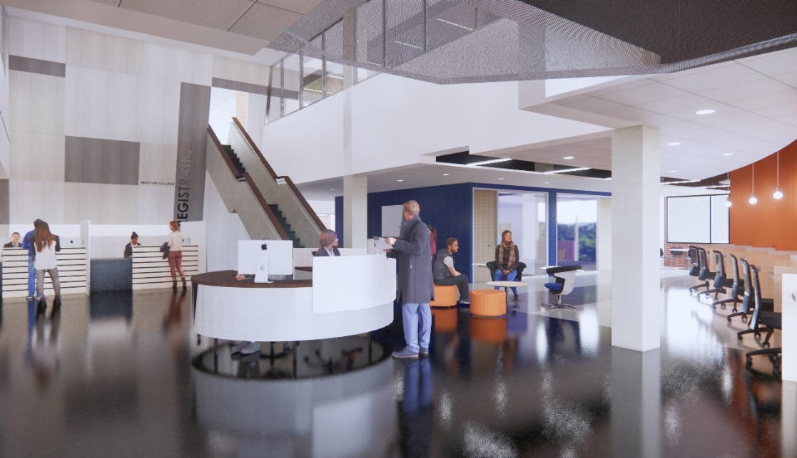
ONE-STOP STUDENT SERVICES CENTER

Slide 7
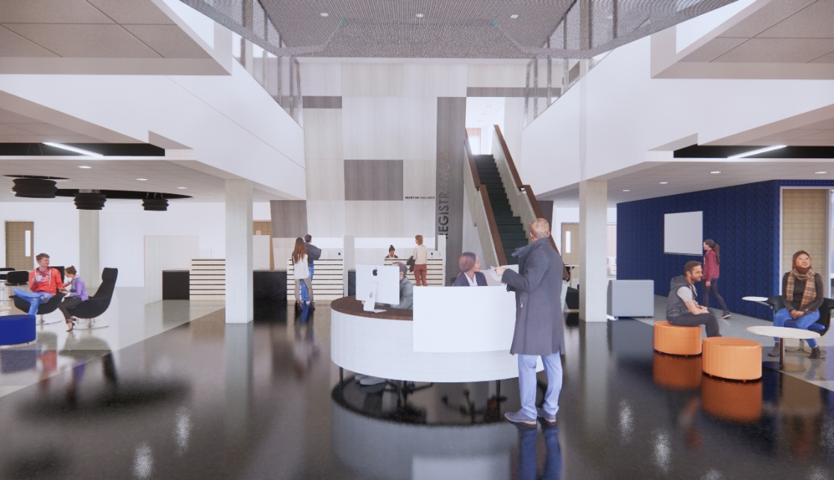
ONE-STOP STUDENT SERVICES CENTER

Slide 8
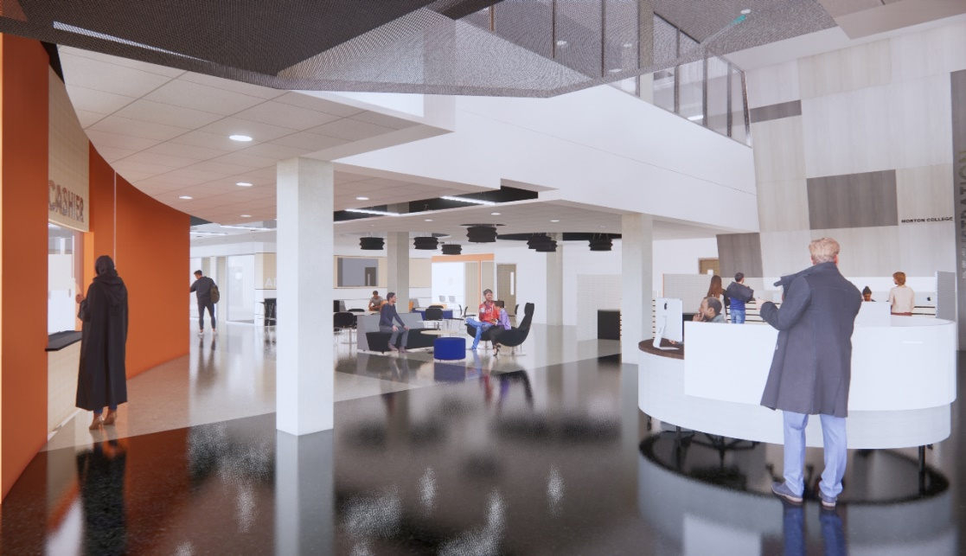
ONE-STOP STUDENT SERVICES CENTER
CIRCULATION DESK

Slide 9
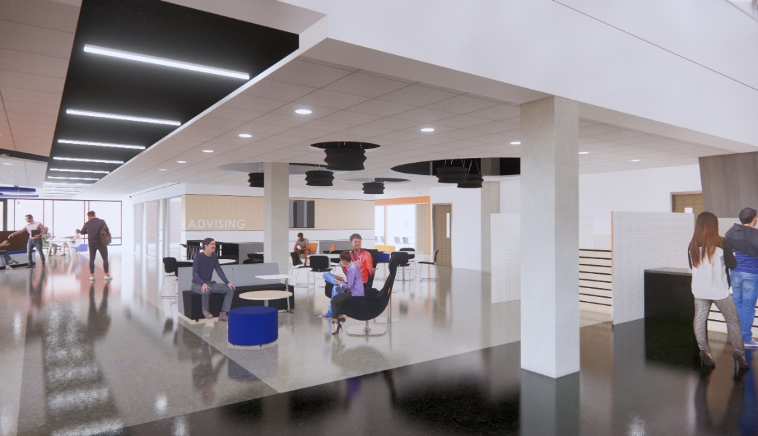
ONE-STOP STUDENT SERVICES CENTER
ADVISING

Slide 10
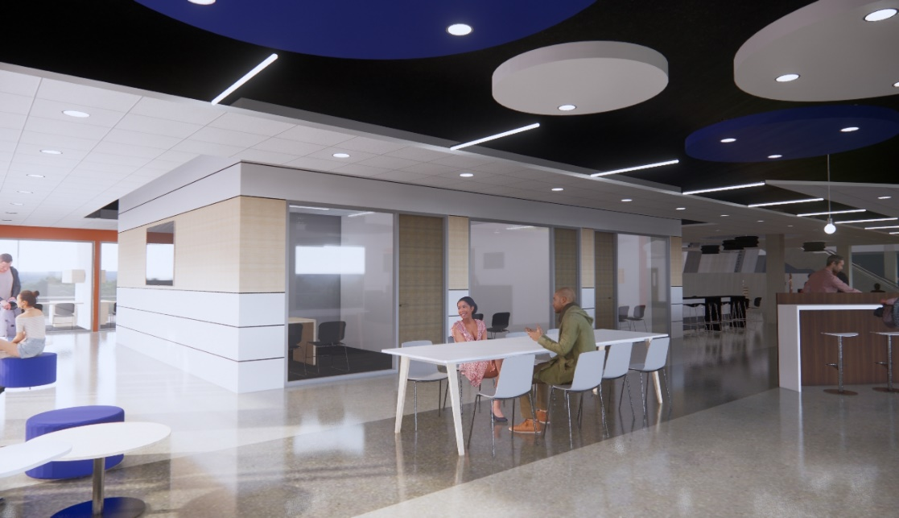
ONE-STOP STUDENT SERVICES CENTER
ADVISING

Slide 11
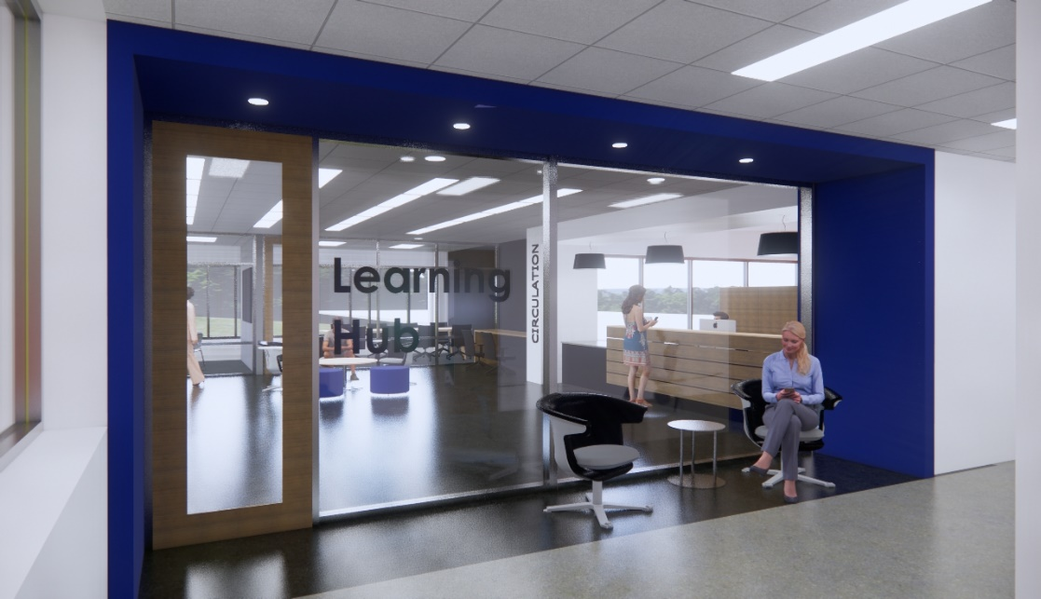
ONE-STOP STUDENT SERVICES CENTER
LEARNING HUB ENTRANCE

Slide 12
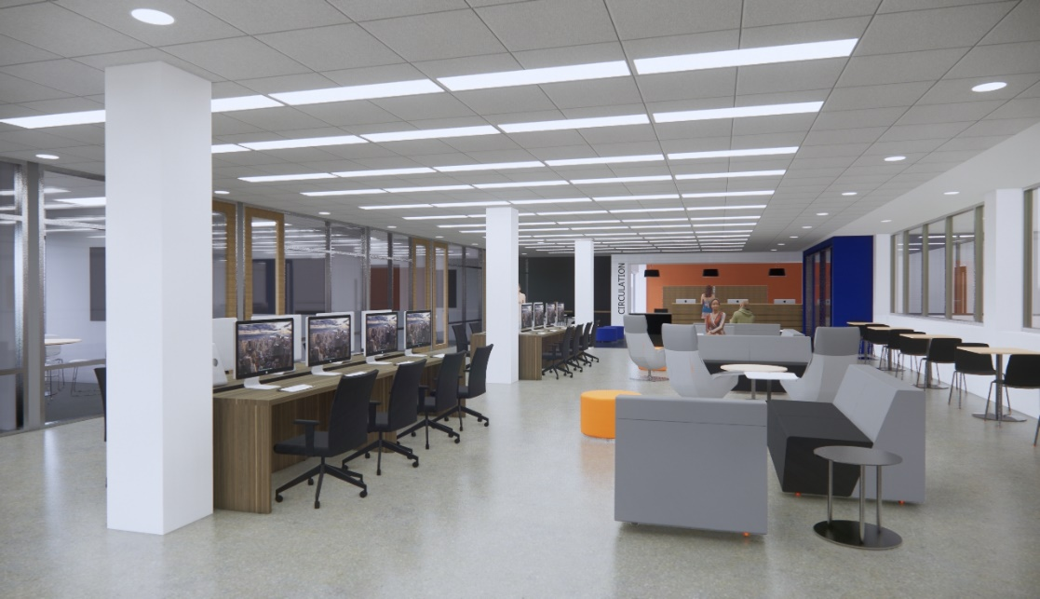
ONE-STOP STUDENT SERVICES CENTER
LEARNING HUB

Slide 13
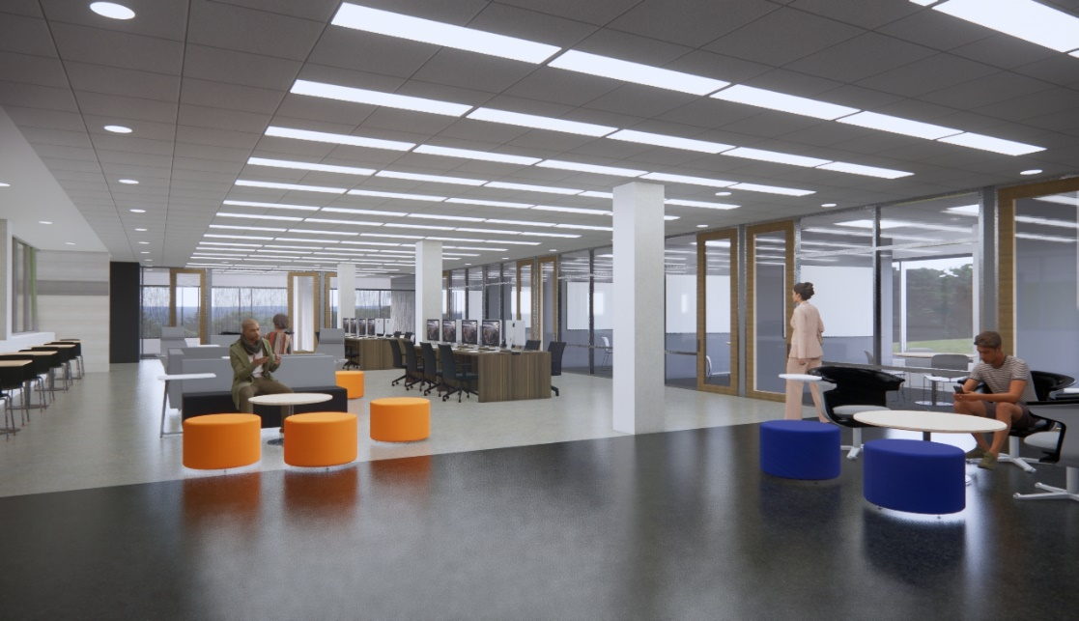
ONE-STOP STUDENT SERVICES CENTER
LEARNING HUB

Slide 14
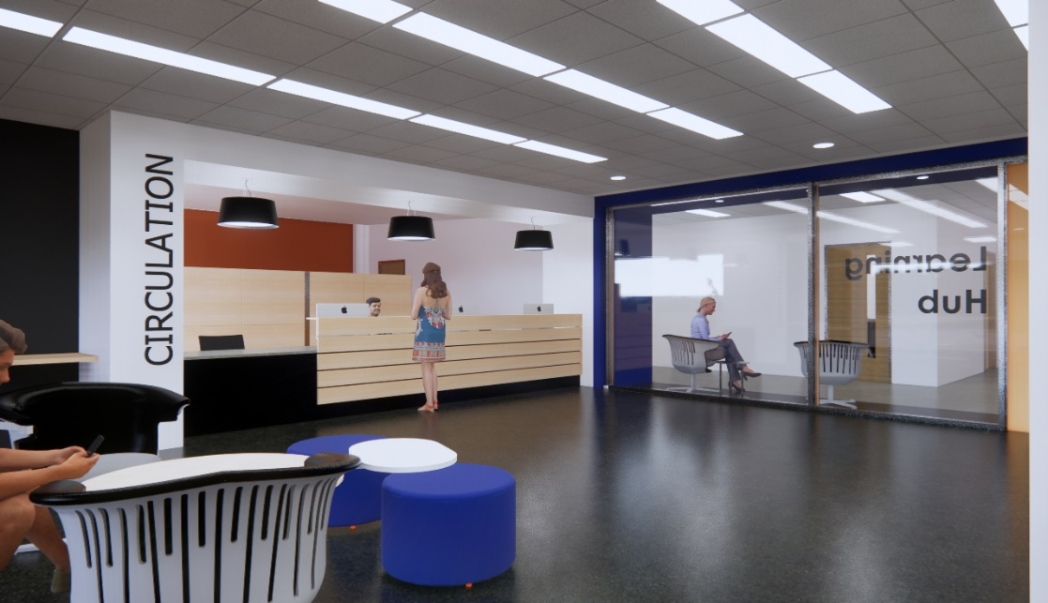
ONE-STOP STUDENT SERVICES CENTER
LEARNING HUB CIRCULATION

Slide 15
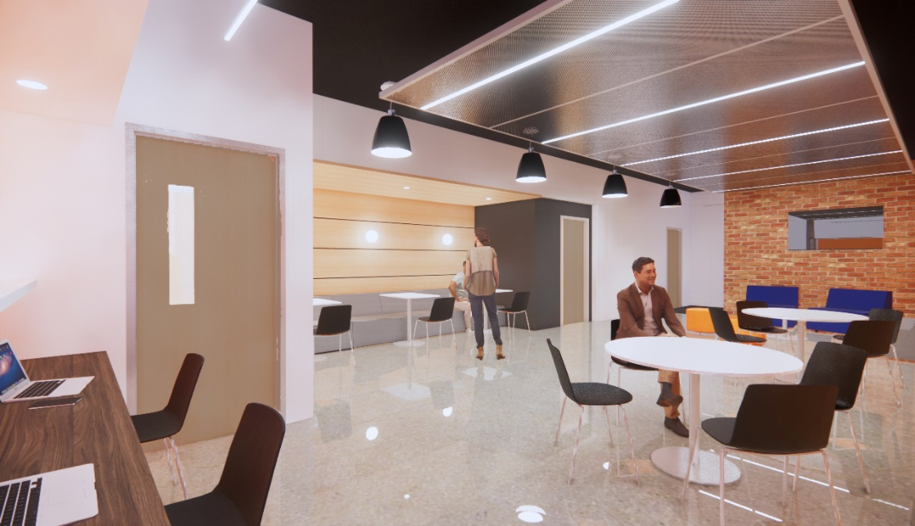
ONE-STOP STUDENT SERVICES CENTER
CAREER SERVICES / FACULTY RESOURCE CENTER

Slide 16
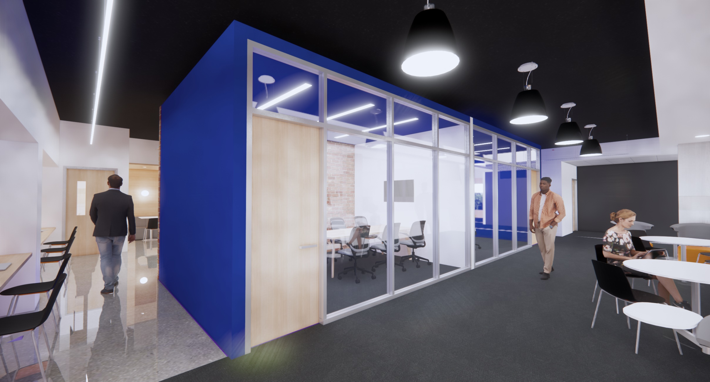
ONE-STOP STUDENT SERVICES CENTER
CAREER SERVICES / FACULTY RESOURCE CENTER

Slide 17
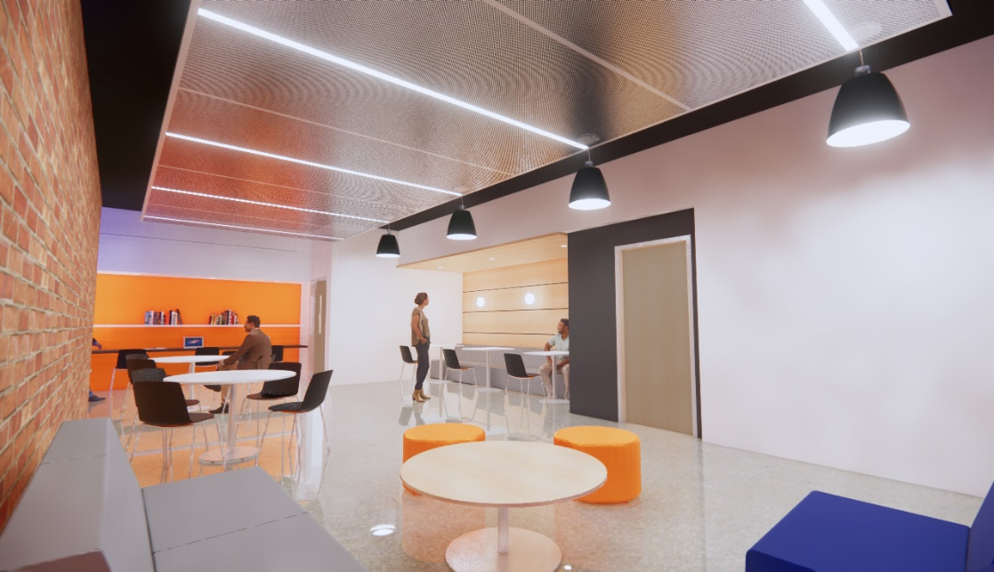
ONE-STOP STUDENT SERVICES CENTER
CAREER SERVICES / FACULTY RESOURCE CENTER

Slide 18
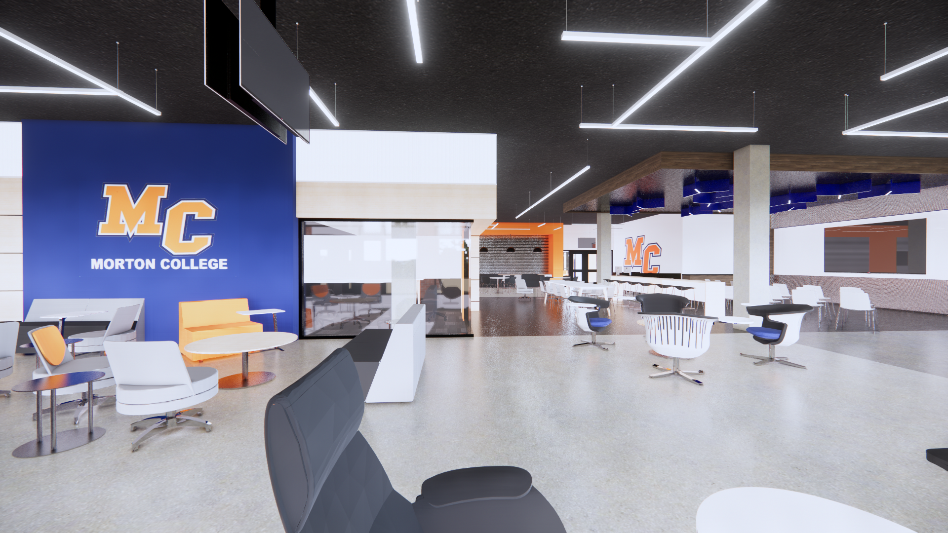
STUDENT UNION

Slide 19
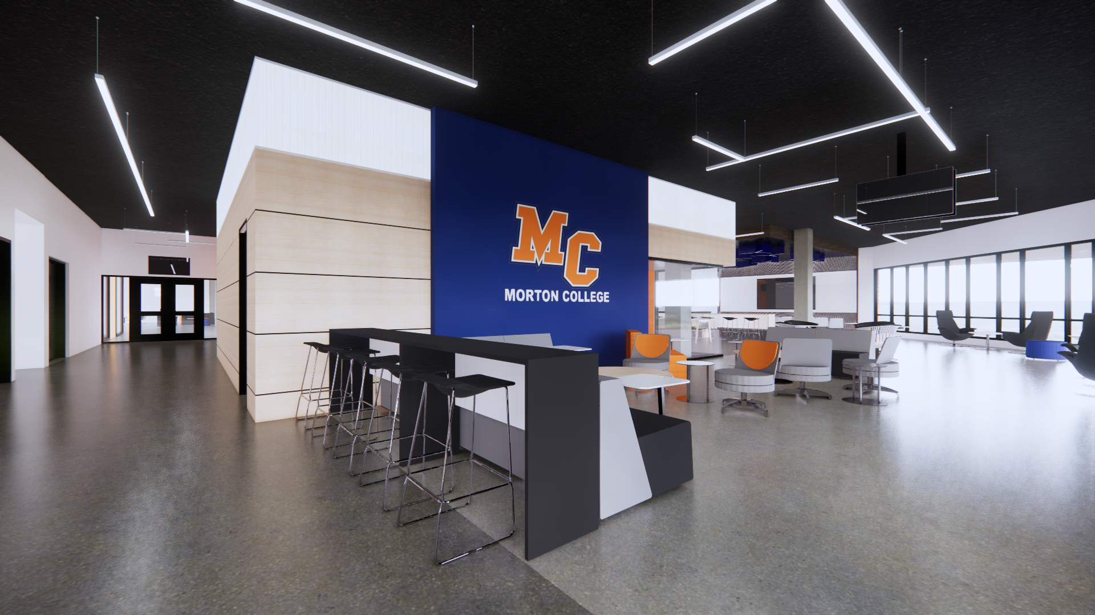
STUDENT UNION

Slide 20
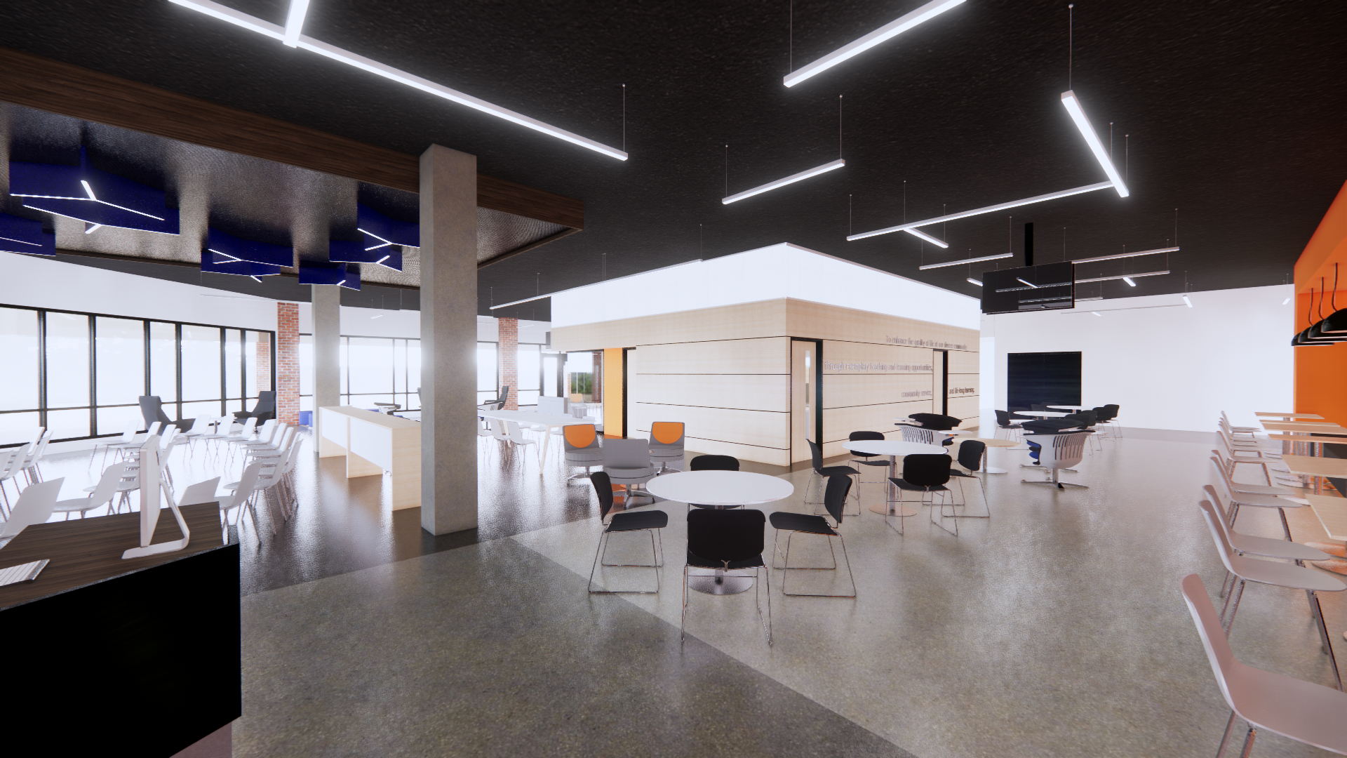
STUDENT UNION

Slide 21
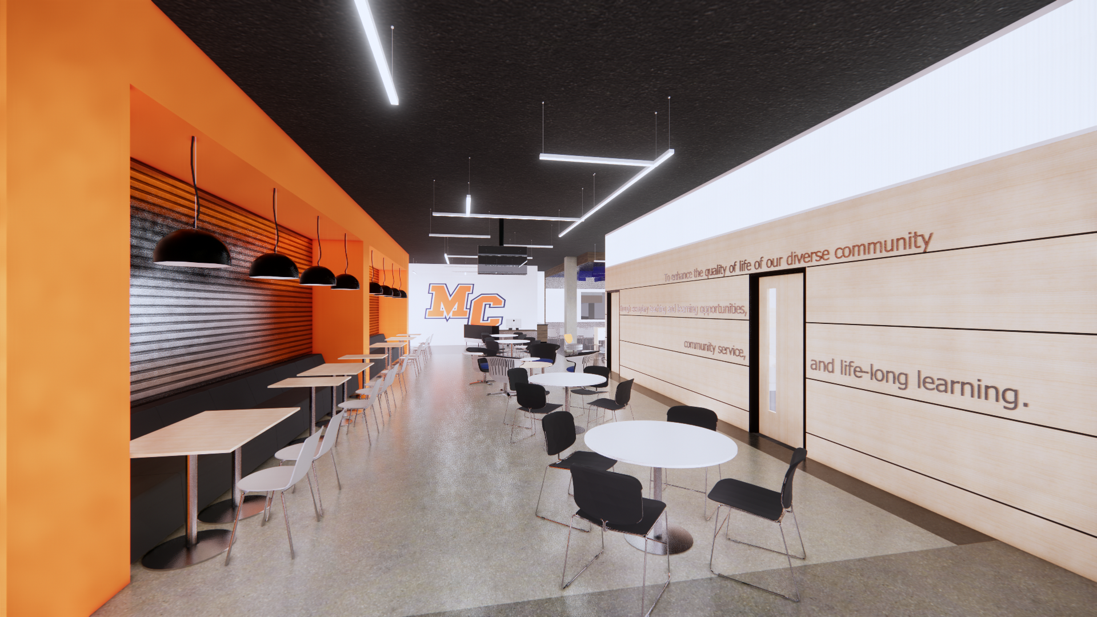
STUDENT UNION

Slide 22
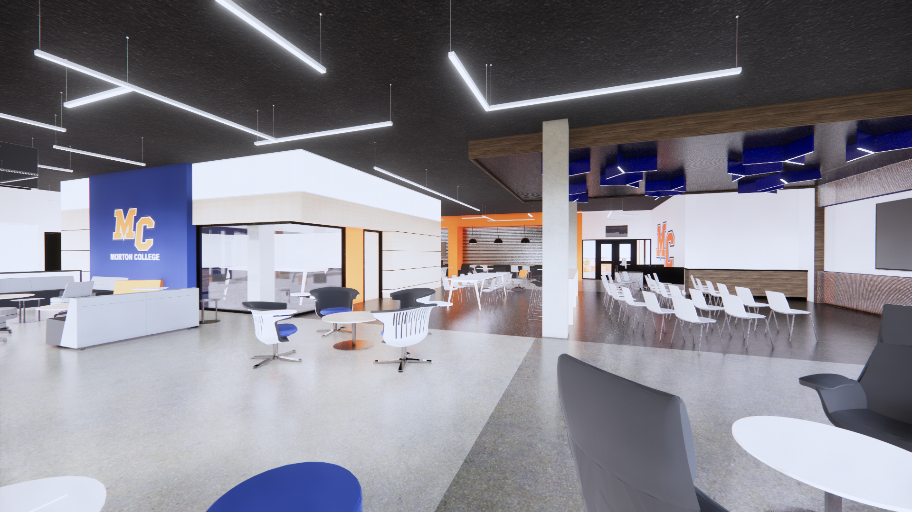
STUDENT UNION

Slide 23
STUDENT UNION

